Slide 1
The Transition of an In-Person Culinary Program to Remote Delivery During the COVID-19 Pandemic for Adolescents with Autism Spectrum Disorder
Jeanette M., Garcia, Ph.D.
Keith Brazendale, Ph.D.
Eunkyung (Muriel) Lee, Ph.D, RDN
University of Central Florida

Slide 2
Background
Multidisciplinary team of 5 students & 4 faculty members
Health Sciences, Biomedical Sciences, Social Work, Psychology, Education
Registered Dietitian
Strong relationship with the partnering school
Design health promotion programs for children & adolescents diagnosed with Autism Spectrum Disorder (ASD)

Slide 3
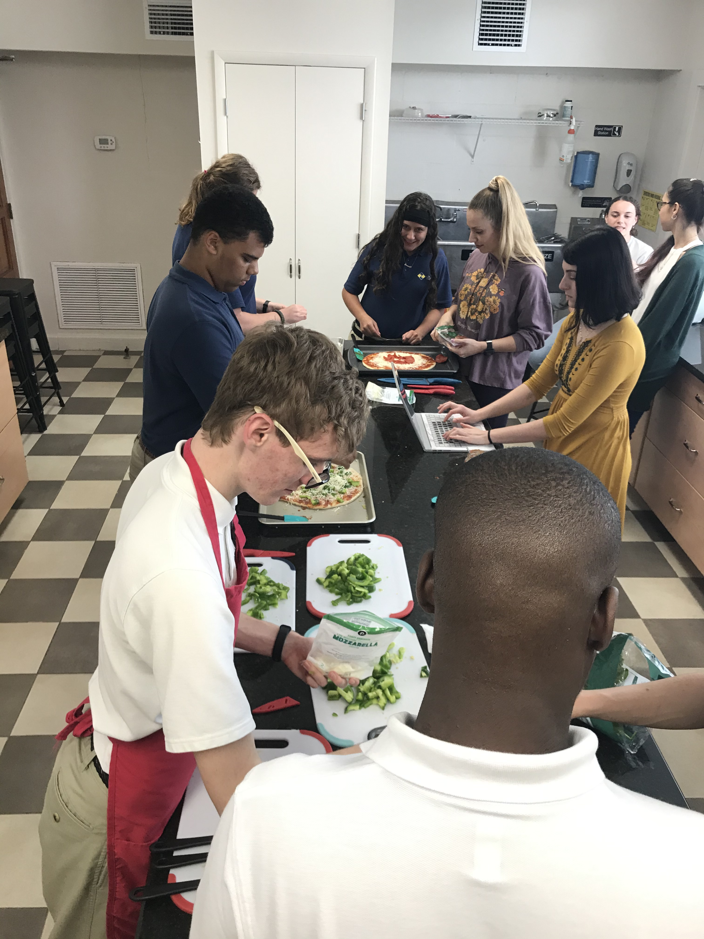
Background
8-week Nutrition Education/Culinary program for 11 high school students with ASD
Location: Private school in Central Florida
2 X week, 45 – 60 minutes each session
Tuesdays: Nutrition Education session
Thursdays: Culinary session

Slide 4
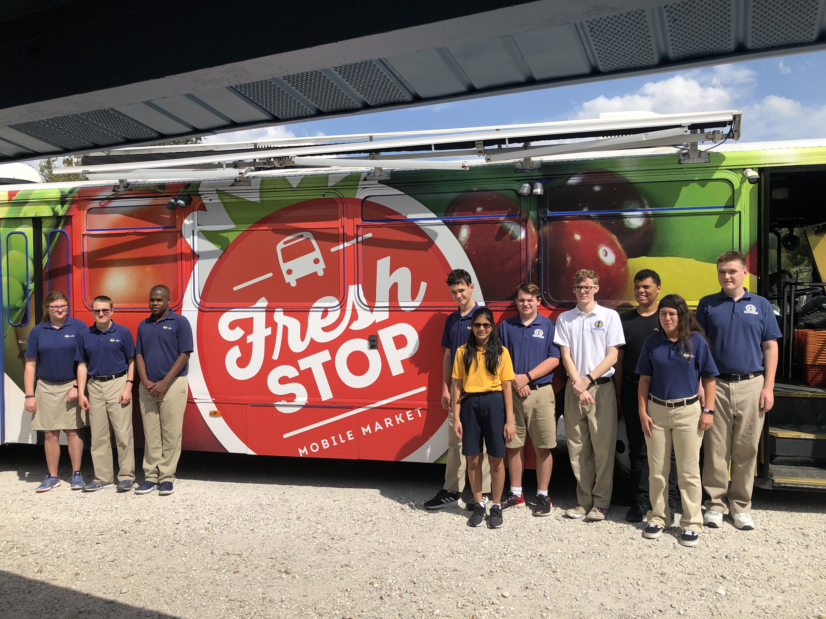
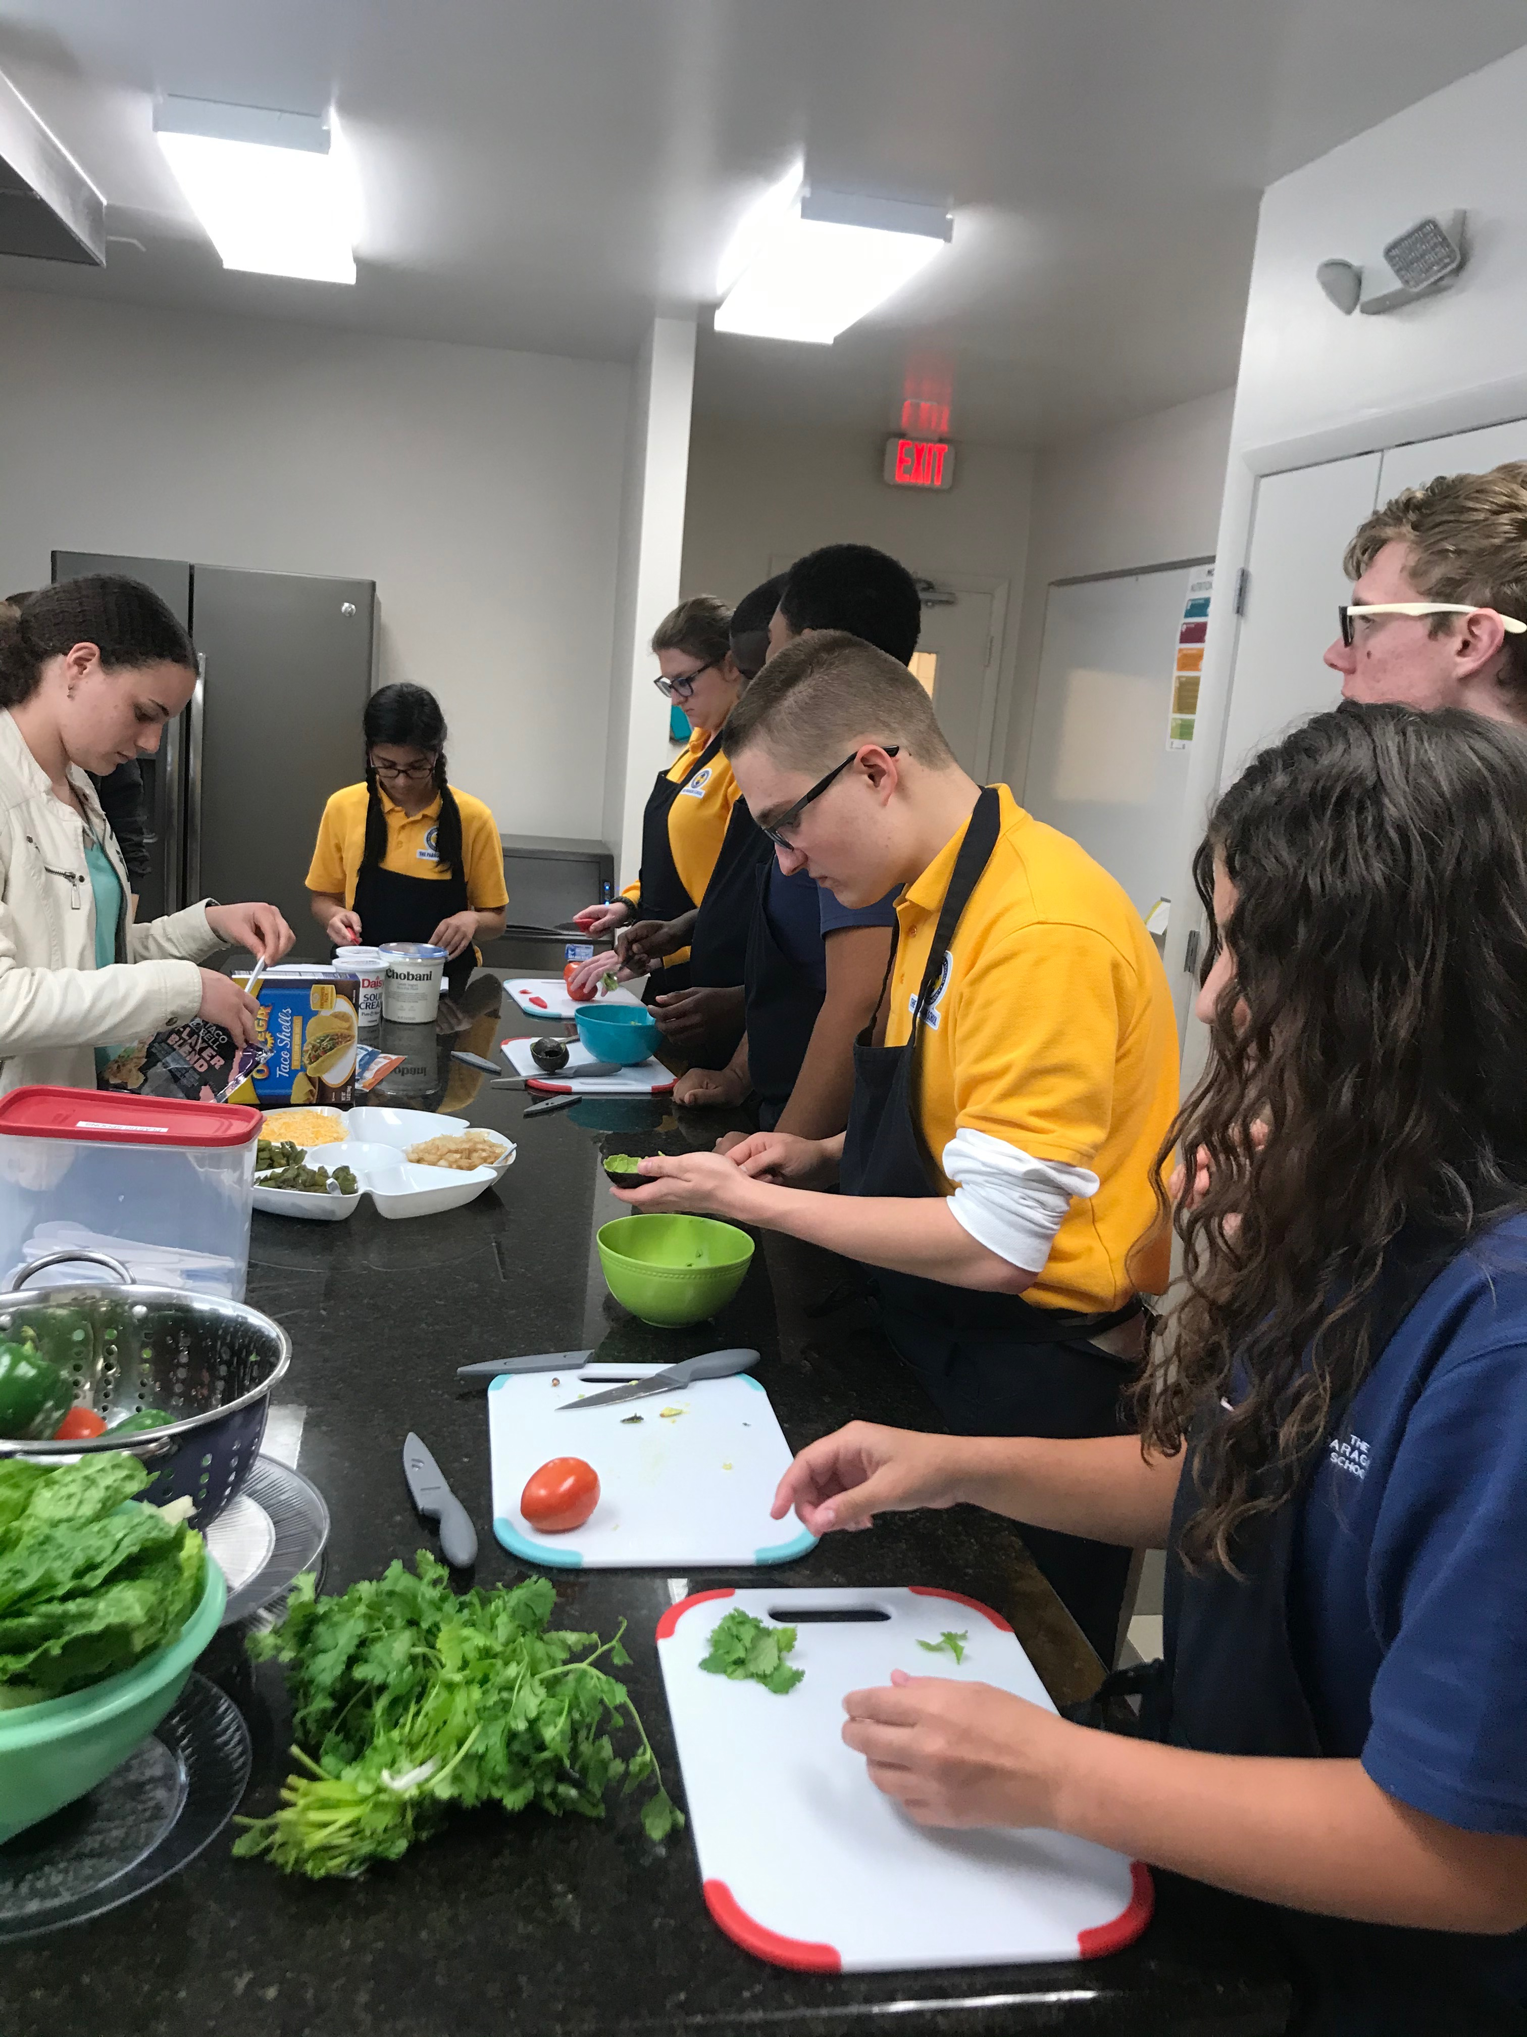
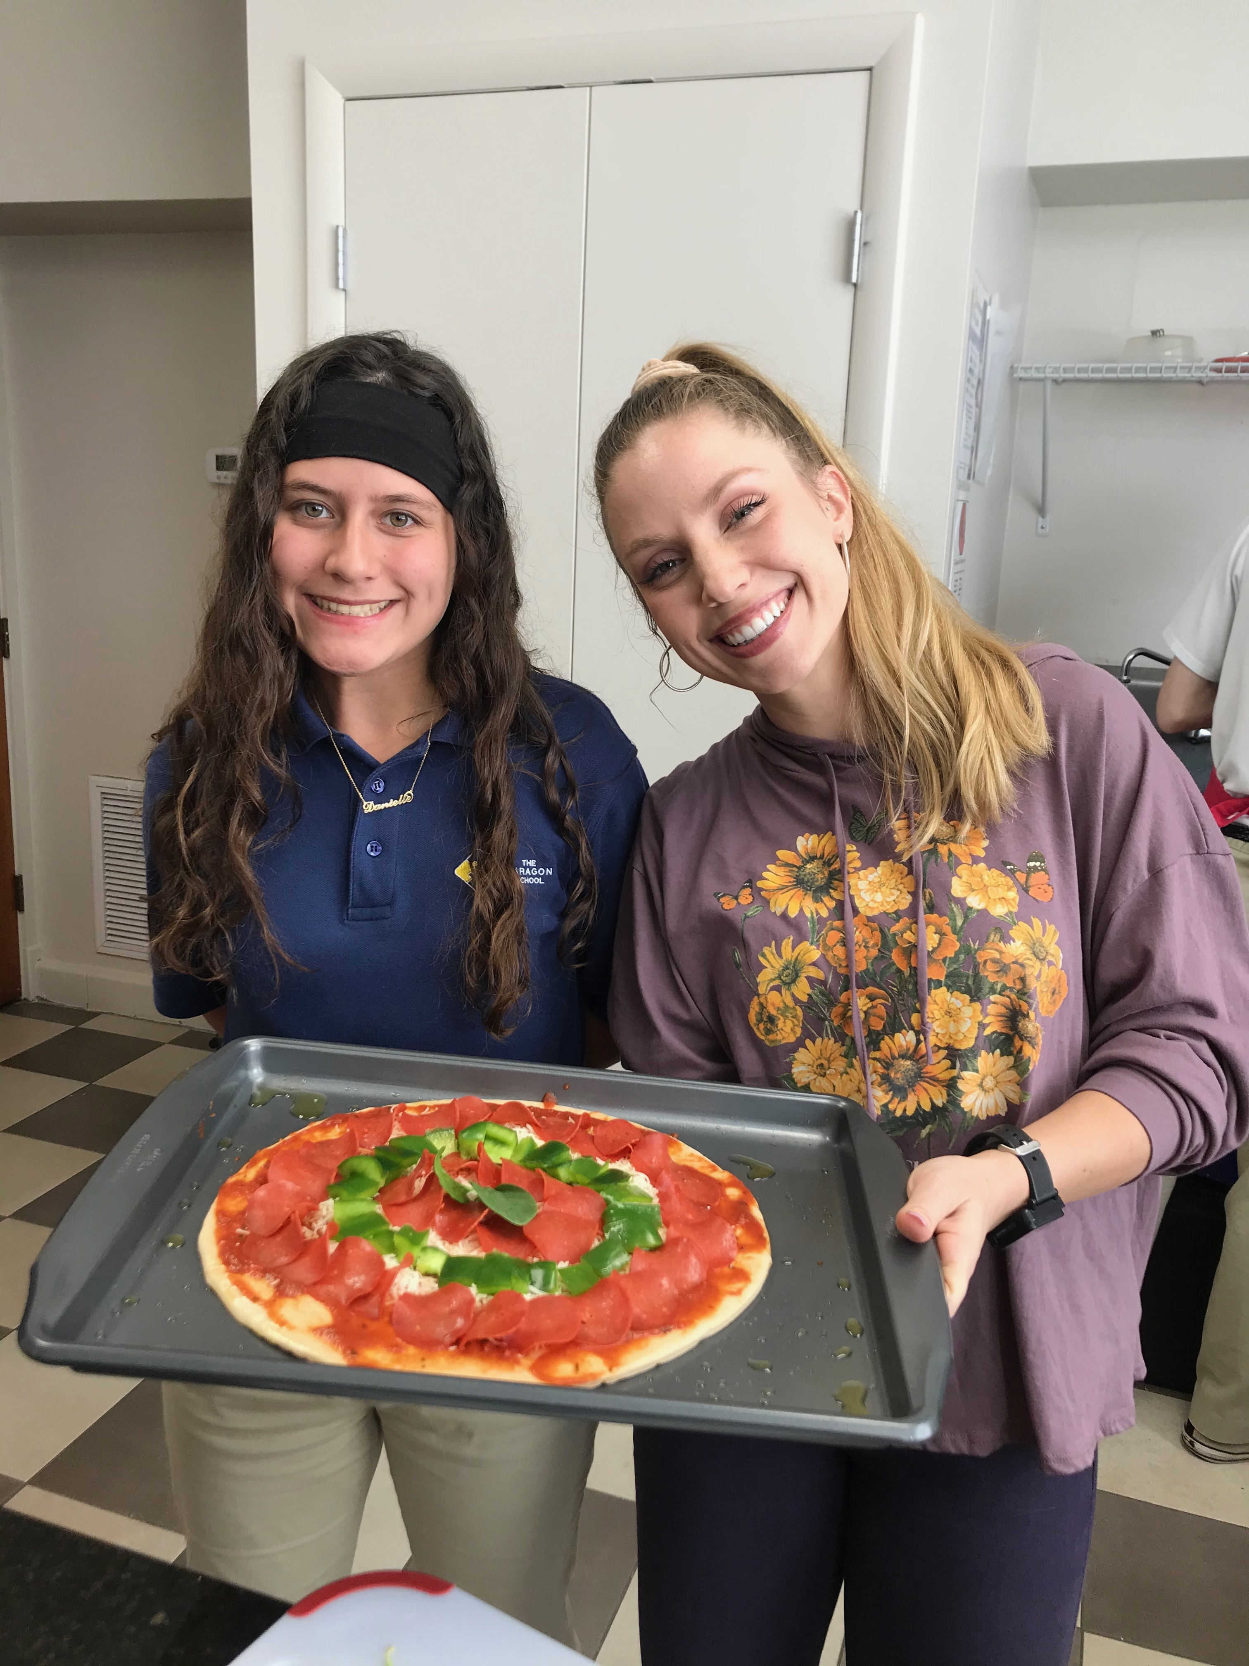
In-person Nutrition Education/Culinary Sessions
Examples of Nutrition Topics
Portion Distortion
Interpreting a Nutrition Label
Grocery shopping
Examples of Culinary Products
Make your own Pizza
Make you own Trail-mix
Do-it-yourself Tacos

Slide 5
Issue Addressed:
Covid-19 pandemic occurred & all schools in Orange County shut down in-person lessons
Disruption in daily schedule
Nutrition Education sessions & culinary program would have to end with 4 sessions remaining

Slide 6
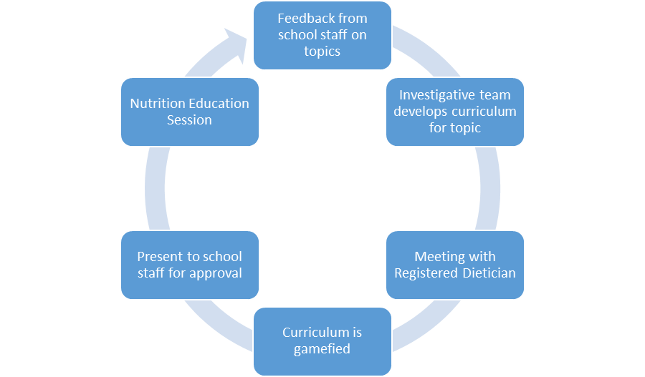
Methods: Transition Period
2-week transition
Preparation
Zoom training

Slide 7
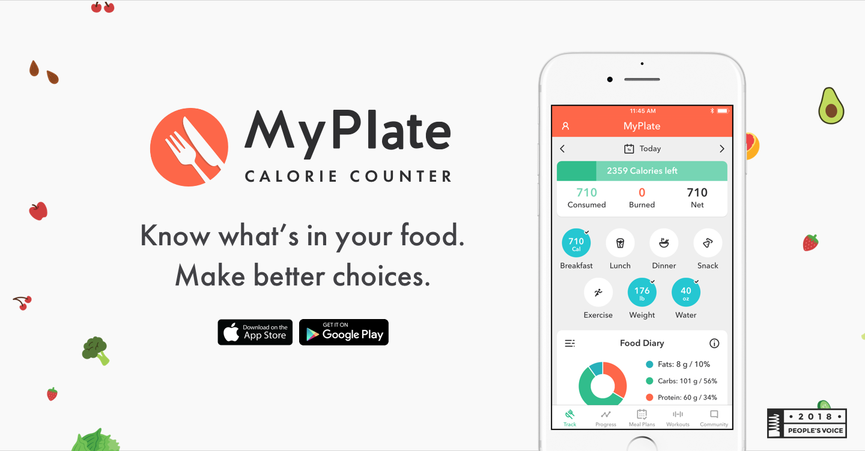
Methods – Program Topics
Topics | Description
Online grocery shopping | How to use Instacart; online shopping at grocery store
Purchasing healthy, non-perishable food | Learning about items could be purchased in bulk
Online apps for healthy eating | USDA MyPlate mobile app for healthy eating
Healthy choices for Take-out/delivery | Examine popular restaurants to select healthy choices

Slide 8
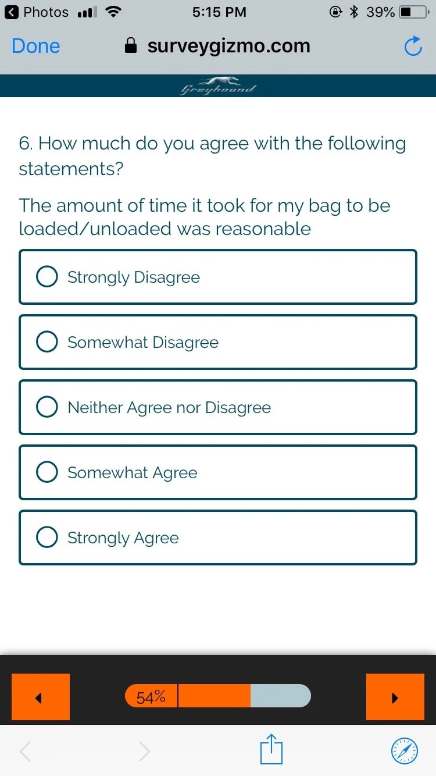
Methods: Evaluation & Assessment
Participant attendance & engagement
Classroom teacher interview
Participants: close-ended & open-ended surveys
Student research assistants: close-ended & open-ended surveys

Slide 9
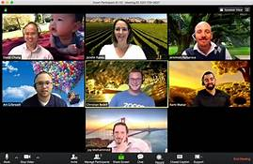
Outcomes: Participant Attendance & Engagement
11 high school students diagnosed with ASD by their primary physician
91% attendance rate
All 11(100%) participants reported they enjoyed the program
All 11 participants reported they would be interested in doing similar health promotion programs using remote-delivery

Slide 10
Outcomes: Participant Open-ended Responses to Remote-Delivery
Positive Responses
Negative Responses
“Talking to the UCF people.”
“The ability to keep learning the course and keep practicing skills.”
“Still got to interact.”
“Zoom didn’t always work on my computer.”
“I miss doing the hands-on lessons.”
“Couldn’t see what the instructor was doing at times.”

Slide 11
Outcomes: Teacher Interview
Participant Experience
“Oh they really liked them! They definitely were more engaged then in their other classes.”
Reasons for Positive Experience
“Well, they [participants] could interact a lot more, especially with the UCF students. I think that was really good for them.”
“And I think it [the remote-delivery program] calmed down their anxiety a bit during the lockdown. This was part of their usual routine and they could go back to that. Not everything was completely disrupted.”
“I think some of them have difficulty with social interaction to a greater extent than some of the others and this was a more comfortable platform for them.”

Slide 12
Outcomes: Teacher Interview
Limitations of Remote-Delivery
“Zoom platform wasn’t always reliable.”
“Lack of in-person interaction and hands-on cooking.”
Suggestions for Future Programs
“A lot of them are now on a tight budget, some of their parents are out of work, and buying cheap items that can be stretched out into a lot of easy, and cheap meals would be huge.”

Slide 13
Outcomes: Student Closed-ended Responses
All 5 students strongly agreed with the following statements:
I have gained experience in teamwork, service, and community leadership.
I felt like I made a difference in the community.
I feel more comfortable working with diverse populations as a result of this project.
I have gained valuable experience and knowledge in designing and implementing community research projects.

Slide 14
Outcomes: Student Open-ended Responses
Question Topic | Summary of Responses
Participant Response | Preference for Zoom sessions for participants with higher social anxiety
Student Learning | Better understanding of real-world challenges for participants, comfortable with diverse population
Surprising Outcomes? | High level of participant interest & engagement
Benefits to Remote-delivery | Parent involvement, participant comfort, continuation of program despite pandemic
Barriers to Remote-delivery | Technological Issues
Feasibility | Feasible, especially with more planning
Suggestions for Future Programs | More planning for remote curriculum, use both remote delivery & in-person if possible, more parent involvement

Slide 15
Outcomes: Student Open-ended Responses
Question | Student Responses
Was there anything you learned from your experience with conducting the Zoom sessions? | “It was easy using the Zoom application because of the many features it offers such as chatting, raising hands, sharing screens, etc. It helped me understand the participants better and how they conveyed their messages, virtually.” “I learned that the participants are very adaptive to the medium in which they are being taught and were still engaged in the learning process without it being face to face.” “I learned more about the student's lifestyles at home—what their parents buy at the grocery stores, how often they grocery shop, who picks up the groceries, etc.”

Slide 16
Outcomes: Student Open-ended questions
Question | Student Responses
Was there anything that surprised you as you did these sessions? | “I was surprised by the level of interest the participants had in the class, despite a global pandemic and a complete change in routine.” “I was surprised at how attentive the participants were, even when we weren’t meeting face-to-face. They gave the same amount of attention and respect online as they did when we physically met with them.” “I was surprised by how engaged the participants were because I originally thought the lack of face to face interaction would cause a lack of interest.”

Slide 17
Discussion: Summary of Findings
Remote-delivery nutrition education program was feasible & acceptable to participants
Students played an important role
Strong community partner is critical
Community-based participatory research
Open communication
Multidisciplinary team is ideal
Different perspectives that complement each other
Program delivery & research opportunities

Slide 18
Conclusion
Although the pandemic disrupted the original, in-person program, the development of the remote-program was a positive result
Multidisciplinary team of students, faculty, & partnering organization was key
Further planning & parent involvement for future programs
Beneficial to students: community engagement, problem-solving skills, teamwork, communication skills, adaptable
Possible alternative to health promotion programs when in-person programs are limited

Slide 19
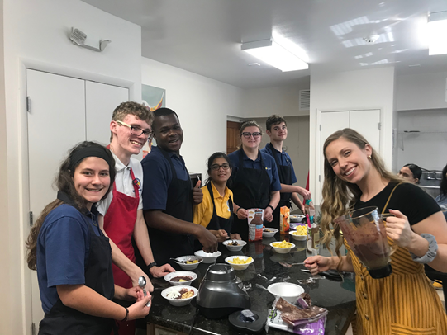
Thank you! Questions?

